Slide 1

ROTARACT INTERNATIONAL SERVICE
TARUN KOTAGIRI
INTERNATIONAL SERVICES DIRECTOR

Slide 2
INTERNATIONAL SERVICES
ROTARACT CLUB OF
KGRCET
Tue 17/07
Brand New Bag
USD 3550
Special Price
BUY NOW
Let’s get started
RID 3150
@
poco

Slide 3


Agenda
What is International Service?
Service Activities of International Avenue
How can you develop yourself in this Avenue
Year plans of International Avenue for the Year 2k21 – 22.

Slide 4
Introduction
The International Service Avenue aims at creating awareness among the students regarding the international issues and bringing them at par with the conditions prevailing internationally.

Slide 5

WHAT IS INTERNATIONATIONAL SERVICE?

Slide 6
WHAT IS INTERNATIONAL SERVICE
International Service encompasses actions taken to expand Rotary's humanitarian reach around the globe and to promote world understanding and peace.
In this area, Rotarians strive for the advancement of international understanding, goodwill, and peace through a world fellowship of business and professional persons united in the ideal of service.

Slide 7
Activities of international avenue

Slide 8
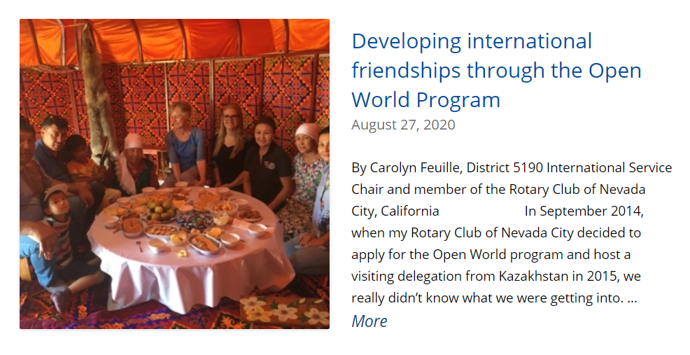

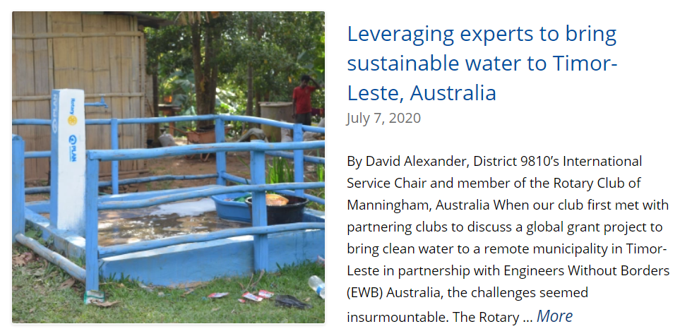

Slide 9

How can you Develop yourself in International Avenue
2021

Slide 10




Build Yourself!
speaking
networking
Team work
Self esteem

Slide 11

YEAR PLANS OF INTERNATIONAL AVENUE

Slide 12
Year Plans
There is no one-way to carry out a International Service project. When it comes to implementing a project, creativity and imagination are the keys to success.
Exchanging Letter Heads.
Youth Exchange Programs.
Collaboration projects with other Districts.
Celebrating World days.
International Cultural Evenings.
Let’s solve as many Community problems as we can this Year forward!

Slide 13

Let’s come up with projects that address priority needs identified by the communities, and let’s help people in helping themselves, and we must also ensure all our projects are environmentally sustainable.

Slide 14
ANY QUESTIONS..?

Slide 15
s

